Slide 1


Classification studies on MDR pathogens based on antibiotic resistance using ML models
SUBJECT :24AIM112&24AIM115
Team Members
Sanjay R - CB.AI.U4AIM24143
Shreevarsinii B - CB.AI.U4AIM24144
Srijan Sivaram A - CB.AI.U4AIM24145
Snendar M S - CB.AI.U4AIM24127

Slide 2
INTRODUCTION:
ANTIBIOTIC RESISTANCE :
Antibiotic resistance occurs when bacteria change so that antibiotic medicines can’t kill them or stop their growth. As a result, bacterial infections become extremely difficult to treat.
Antibiotic resistance is a type of antimicrobial resistance. Fungi, parasites and viruses can also develop drug resistance.
I

Slide 3
MULTIDRUG RESISTANCE (MDR):
Multidrug resistance (MDR) is when bacteria or viruses are resistant to multiple antibiotics or antivirals. MDR can also refer to the ability of cells to resist a variety of drugs.
Causes
Overuse of antibiotics: Taking antibiotics for longer than needed or when they aren't needed can cause bacteria to become resistant
Ineffective drugs: Using poor quality drugs or single drugs can lead to drug resistance
Premature treatment interruption: Stopping treatment too early can cause drug resistance
Natural growth of bacteria: Bacteria naturally grow over time, which can lead to resistance
I

Slide 4
PROBLEM STATEMENT
Multidrug-resistant (MDR) pathogens are becoming a major healthcare challenge, making it harder to treat infections effectively. This study aims to use machine learning (ML) models to classify MDR pathogens based on their antibiotic resistance patterns. The goal is to improve the accuracy of resistance predictions and help guide better treatment decisions in healthcare settings.

Slide 5
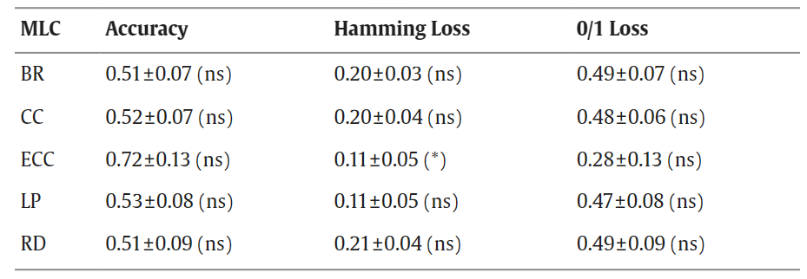
Literature Review
Multi-label classification for multi-drug resistance prediction of Escherichia coli, Computational and Structural Biotechnology Journal, 2022
Objective :
The applications of MLC methods on multi-drug resistance prediction.

Slide 6
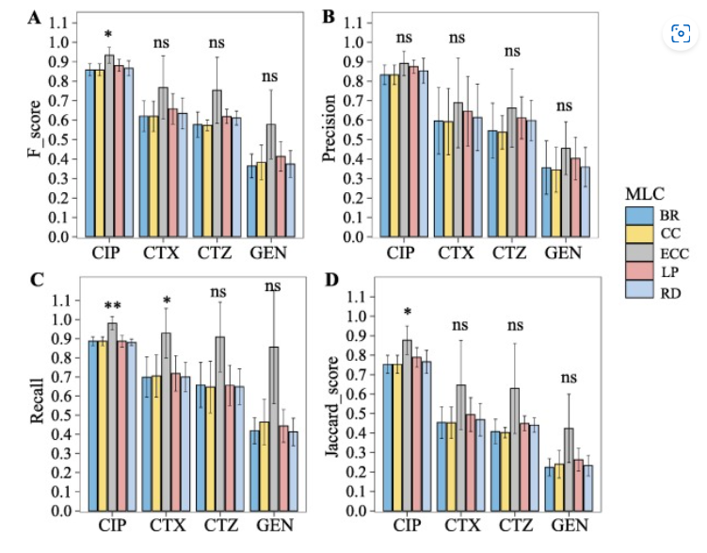
Limitations :
The ECC model has good scalability, and can be combined with multiple base classifiers, such as neural networks. MLC methods performed well on CIP drug, and worse on GEN drug.

Slide 7
METHODOLOGY
Data Collection :
We collect the attributes for the following 6 species -
Enterococcus faecium
Staphylococcus aureus (MRSA – Methicillin-resistant S. aureus)
Klebsiella pneumoniae
Acinetobacter baumannii
Pseudomonas aeruginosa
Enterobacter species
Which has the following attributes -
Organic group
Scientific name
Antibiotic
Resistance phenotype

Slide 8
Using NN :
The limitations of the literature review, state that by using NN the accuracy of the model can be increased so that the model can be more effective in classifying and predicting whether the pathogen shows resistance or not.

Slide 9
Extensively drug-resistant bacteria: Which ethical issues? Bactéries hautement résistantes émergentes : quels enjeux éthiques ?
P. Vassala, P. Berthelotb,∗, J.P. Chaussinandc, S. Jayd, J.P. de Filippise, C. Auboyerf, F. Renouxg, D. Bedoinh, 16 May 2017.
Terre d’éthique, a French territorial ethics committee, was asked to reflect on this topic by the infection control unit of a French University Hospital as it raises many ethical issues
Objective – How can we preserve the well-being of patients presenting with infections caused by extensively drug-resistant bacteria (EDRBs) and that of their contacts without inducing any loss of chance of survival, all the while living together and controlling the spread of these EDRBs?
Results – The right to making a free and informed choice by the patient is one of the core principles of the ethical approach. Commonly accepted that medical information can be shared between physicians involved in the management of a specific patient under the Article L.1110-4 of the Public Health Code. The creation and dissemination of a register (list of names of contacts or infected patients) entails responsibility of the infected person and that of the community. This responsibility leads to an ethical dilemma as protecting the group (the whole population) necessarily means limiting individual freedom.
Conclusion – We did not aim to answer our problematic but merely wanted to show the complexity of EDRB spread in a broader societal and economic context, all the while respecting the rights of patients.

Slide 10
Control of Antimicrobial Resistance Requires an Ethical Approach-Ben Parsonage.et.al.,
More pertinent to antimicrobial prescribing, the term non-maleficence meaning‘to do no harm’ or rather inflicting the least harm possible to reach a beneficial outcome, defines the choice between immediate benefit from anti-infectives and potential lack oftherapies for that patient in the future.
Prescribing restrictions challenge traditional autonomy of individual practitioners. Autonomy itself demonstrates an ethical principle intimating freedom from external control or influence
For prescribers, decisions must be made over when patients should receive antibiotics and which class or combination would be most beneficial.
The practice of buying antibiotics froma shop or online, without any form of prescription, promotesAMR because it might not be the correct drug or dose for the user
Most antimicrobial consumption in agriculture is aimed at growth promotion or infection prevention, rather than direct treatment of infection, and this obviously raises ethicalm issues. There are economic reasons for livestock workers to use antimicrobials because production benefits could be minimal even within optimized systems.

Slide 11
The Ethical Significance of Antimicrobial Resistance
Authors: Jasper Littmann, Institute of Experimental Medicine, Christian-Albrechts University Kiel
A. M. Viens, Southampton Law School, University of Southampton
Introduction: The paper discusses the ethical challenges AMR poses, emphasizing that AMR is not merely a technical or medical problem but a complex global issue with significant ethical implications. It states that “AMR has been described as one of the major threats to individual and population health in the 21st century”.
Objective: The paper explains -
Why AMR is an ethical issue?
"AMR is putting current and future populations at substantial risk of injury, loss and death"
What ethical issue does AMR raise?
"The dilemma we face is thus that the more extensively we use antibiotics, the faster we will create antibiotic resistance"
How should we approach the ethical issue raised by AMR?
"Successful responses to the problem of AMR will not only be a scientific or medical undertaking, but it must also be an ethical undertaking"
Conclusion: "We believe that the articles in this symposium make a strong case for including ethics, which has not been traditionally associated with being central to infectious disease and global health policy, into the development of the policy responses to AMR that are so urgently needed"

Slide 12
Ethics and antibiotic resistance
Euzebiusz Jamrozik and George S. Heriot
Usage of the antibiotics: It is noted that patients often stop the course of the antibiotics soon after the symptoms are cured this leads to further antibiotic resistance developed by the microbes
Medical bias: The prescriber may overprescribe the antibiotics in the case of low-income, less educated and rural population, and the distrust in the physicians
Social stigma: Being identified as a carrier can result in restricted access to healthcare and mental health issues due to stigmatization
Responsibilities: Not only do social determinants of health make infectious disease episodes more likely, they also promote the spread of resistant organisms (and resistance traits between organisms) as much of the environment in poor communities is contaminated with resistant bacteria
Justice and equality: Low-income countries face a disproportionate burden of antibiotic resistance due to limited healthcare access, poor sanitation, and lack of regulation.

Slide 13
INNOVATIVE APPROACH
In comparison to the previous solution to the problem statement, our project brings a unique solution as we are finding the resistance phenotype for not one but six pathogens.
In our project, we try to find a particular antibiotic for a particular pathogen instead of giving an antibiotic for a spectrum of pathogens.

Slide 14
Thank you

